Slide 1
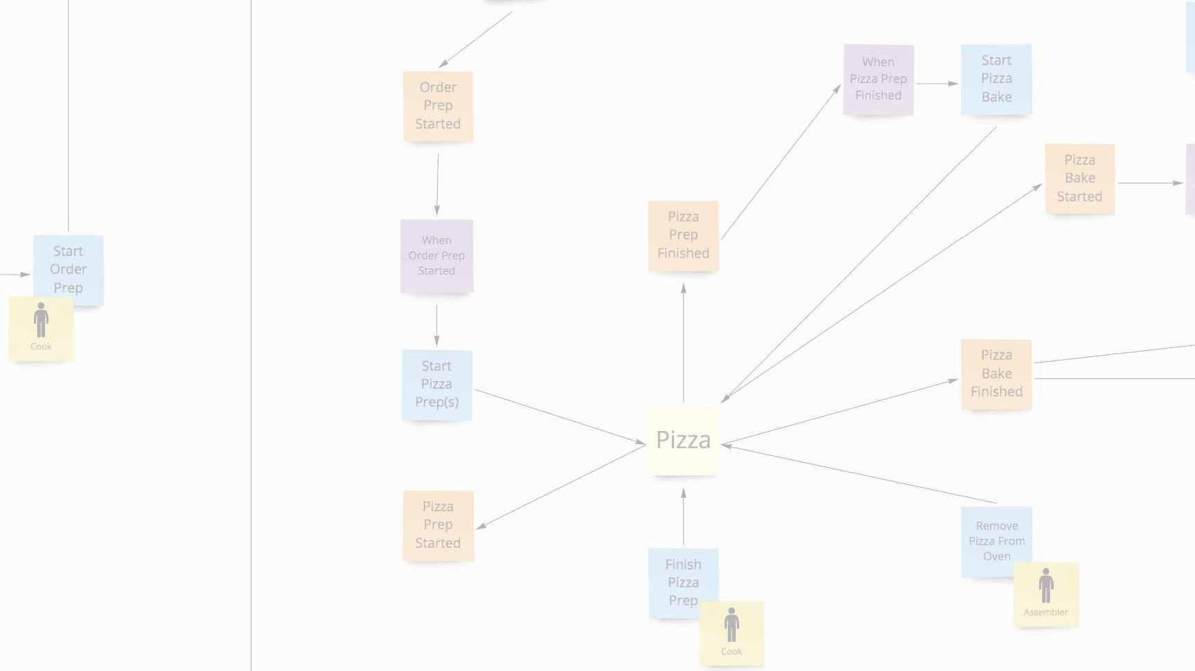
course introduction
Domain-Driven Design and Event-Driven Microservices
Matt Stine (@mstine) http://mattstine.com matt.stine@gmail.com

Slide 2
overview
Participants will understand:
Why DDD is an effective tool for designing evolutionary architectures.
The basic concepts of DDD (DDD 101).
The importance of the Ubiquitous Language.
How DDD can effectively be combined with multiple technical architectures.

Slide 3
overview
Participants will be able to:
Leverage Event Storming to arrive at a candidate domain model.
Translate an Event Storm into User Stories.
Effectively apply DDD patterns to design modules that can be evolved into event-driven microservices.
Effectively leverage Hexagonal Architecture to implement modules that can be evolved into event-driven microservices.

Slide 4

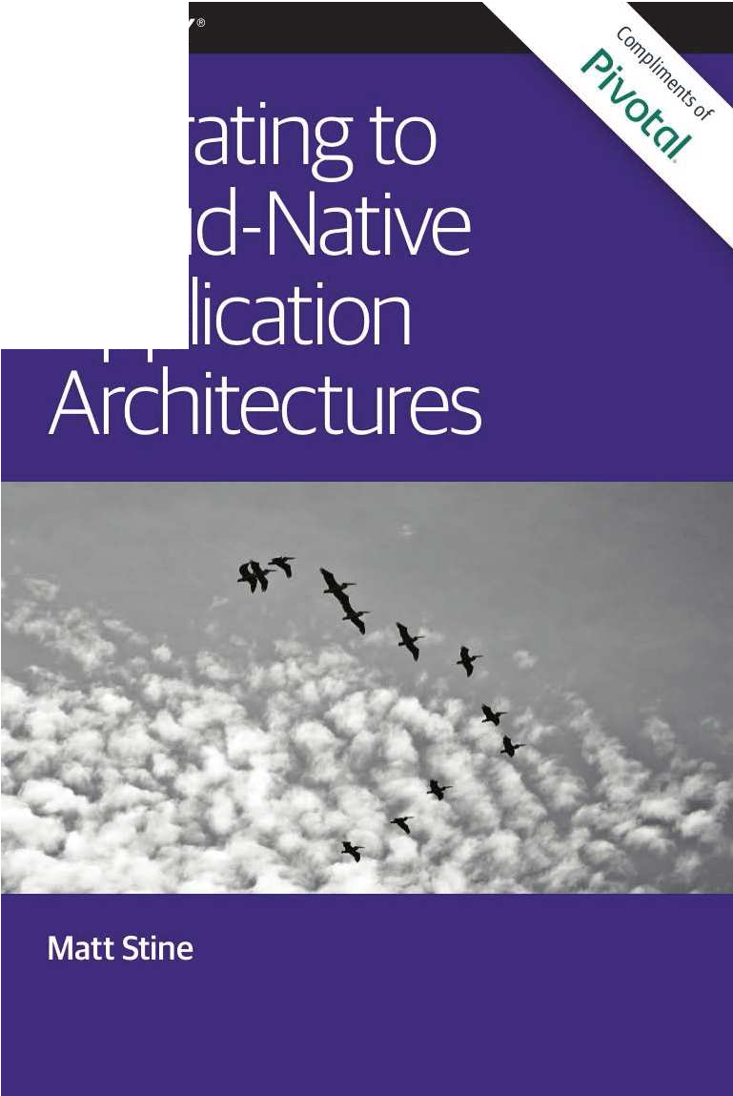

Instructor: matt stine
■
Global Field CTO / Chief Architect at Pivotal
18 year Enterprise IT veteran developer / architect
6 years focused on Cloud Native Platforms and Architecture
■
Frequent conference circuit speaker
Host of Software Architecture Radio http://softwarearchitecturerad.io
I wrote a little cloud book… https://www.oreilly.com/programming/free/ migrating-cloud-native-application- architectures.csp

Slide 5
logistics
Visual content will be delivered via the ON24 platform (what you’re seeing).
You can ask questions in the ON24 Group Chat or Q&A Panel (preferred).
Questions will be answered via the audio channel.
I’ll ask questions via the audio channel, you can answer via Group Chat.
We will take fairly frequent breaks.

Slide 6
Day One
Class Introduction
(10 minutes)
Why do we need DDD?
(15 minutes)
What is the Ubiquitous Language and why is it so important?
(15 minutes)
Open Q&A and Class Discussion
(10 minutes)
Break
(10 minutes)

Slide 7
Day One
DDD 101: Strategic Design
(25 minutes)
Open Q&A and Class Discussion
(10 minutes)
DDD 101: Tactical Design
(25 minutes)
Open Q&A and Class Discussion
(10 minutes)
Overview of Event Storming
(15 minutes)

Slide 8
Day One
Break
(10 minutes)
Intro to the Pizza Shop Domain
(10 minutes)
Open Q&A and Class Discussion
(10 minutes)
Pizza Shop Event Storming Exercise
(20 minutes)
Pizza Shop Event Storming Solution
(15 minutes)

Slide 9
Day One
Event Storming → DDD / User Stories / TDD
(20 minutes)
Day One AMA
(10 minutes)

Slide 10
Day TWO
Day One Recap
(10 minutes)
DDD and Technical Architectures
(25 minutes)
Overview of the Pizza Shop Coding Exercise Environment
(10 minutes)
Lab 1: TDD Aggregate Root: Commands with Business Logic and Invariants
(25 minutes)
Lab 2: TDD Aggregate Root: Publish Domain Events
(25 minutes)

Slide 11
Day TWO
Lab 3: TDD Repository: Create Repositories and Add Domain Events
(25 minutes)
Lab 4: TDD Repository: Rehydrate Aggregates by Reference
(25 minutes)
Lab 5: TDD Policy: Subscribe to Event within Aggregate / Create CQRS View
(25 minutes)
Lab 6: TDD Application Service: Expose Business Interface and Transactions
(25 minutes)
Lab 7: TDD Policy: Subscribe to Event from Adjacent Aggregate / Update State
(25 minutes)

Slide 12
Day TWO
Day Two AMA
(10 minutes)
Conclusion

Slide 13
thank you!
Domain-Driven Design and Event-Driven Microservices
Matt Stine (@mstine) http://mattstine.com matt.stine@gmail.com

Slide 14
Why DDD?
Domain-Driven Design and Event-Driven Microservices
Matt Stine (@mstine) http://mattstine.com matt.stine@gmail.com

Slide 15
What is the State of Microservices
in 2018?

Slide 16

We built the WRONG microservices!

Slide 17
We built TOO MANY microservices!

Slide 18
We DIDN’T REALLY NEED microservices!

Slide 19

We created the SAME OLD ARCHITECTURE with microservices!

Slide 20
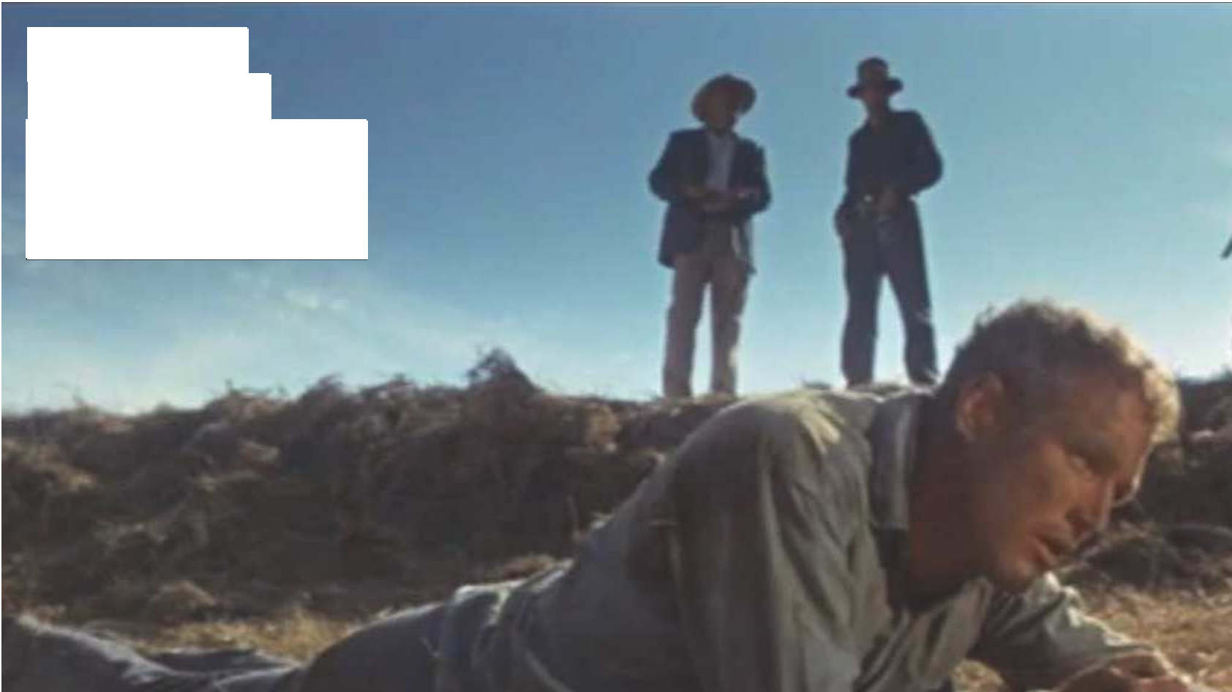



what we’ve got here is failure to
DESIGN

Slide 21
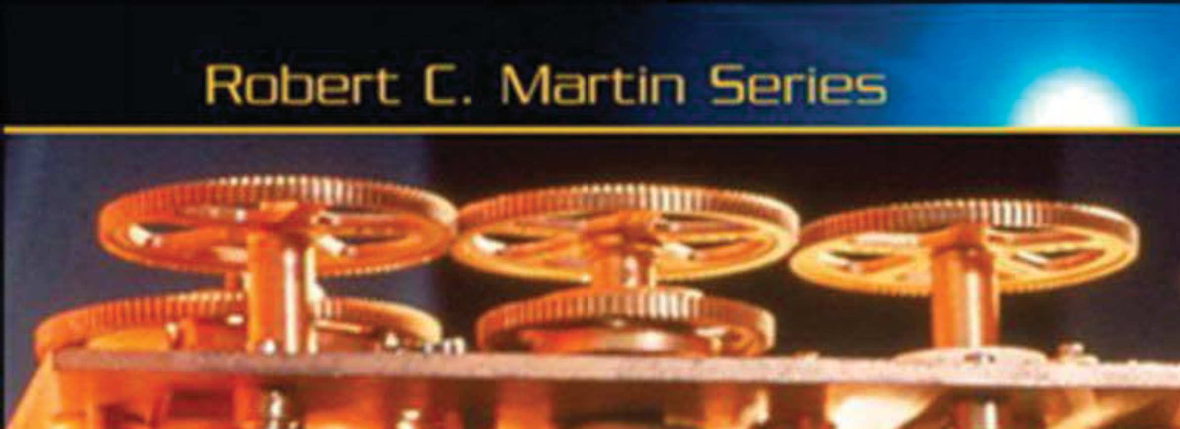

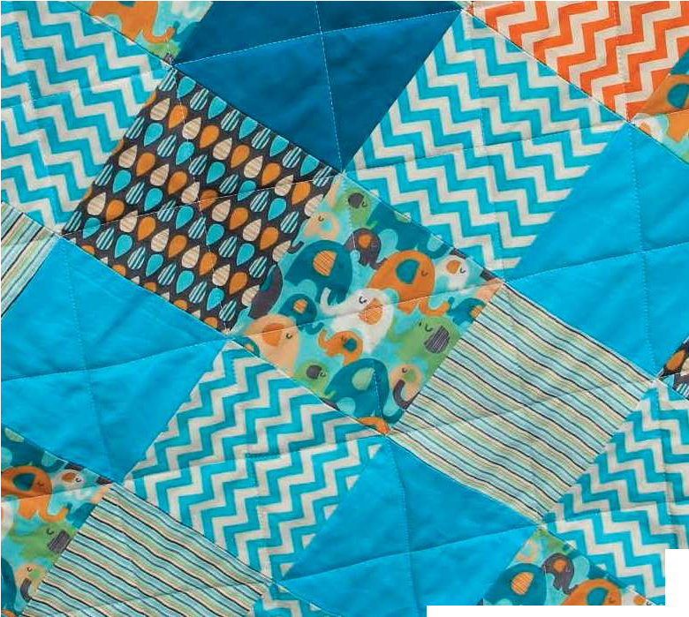

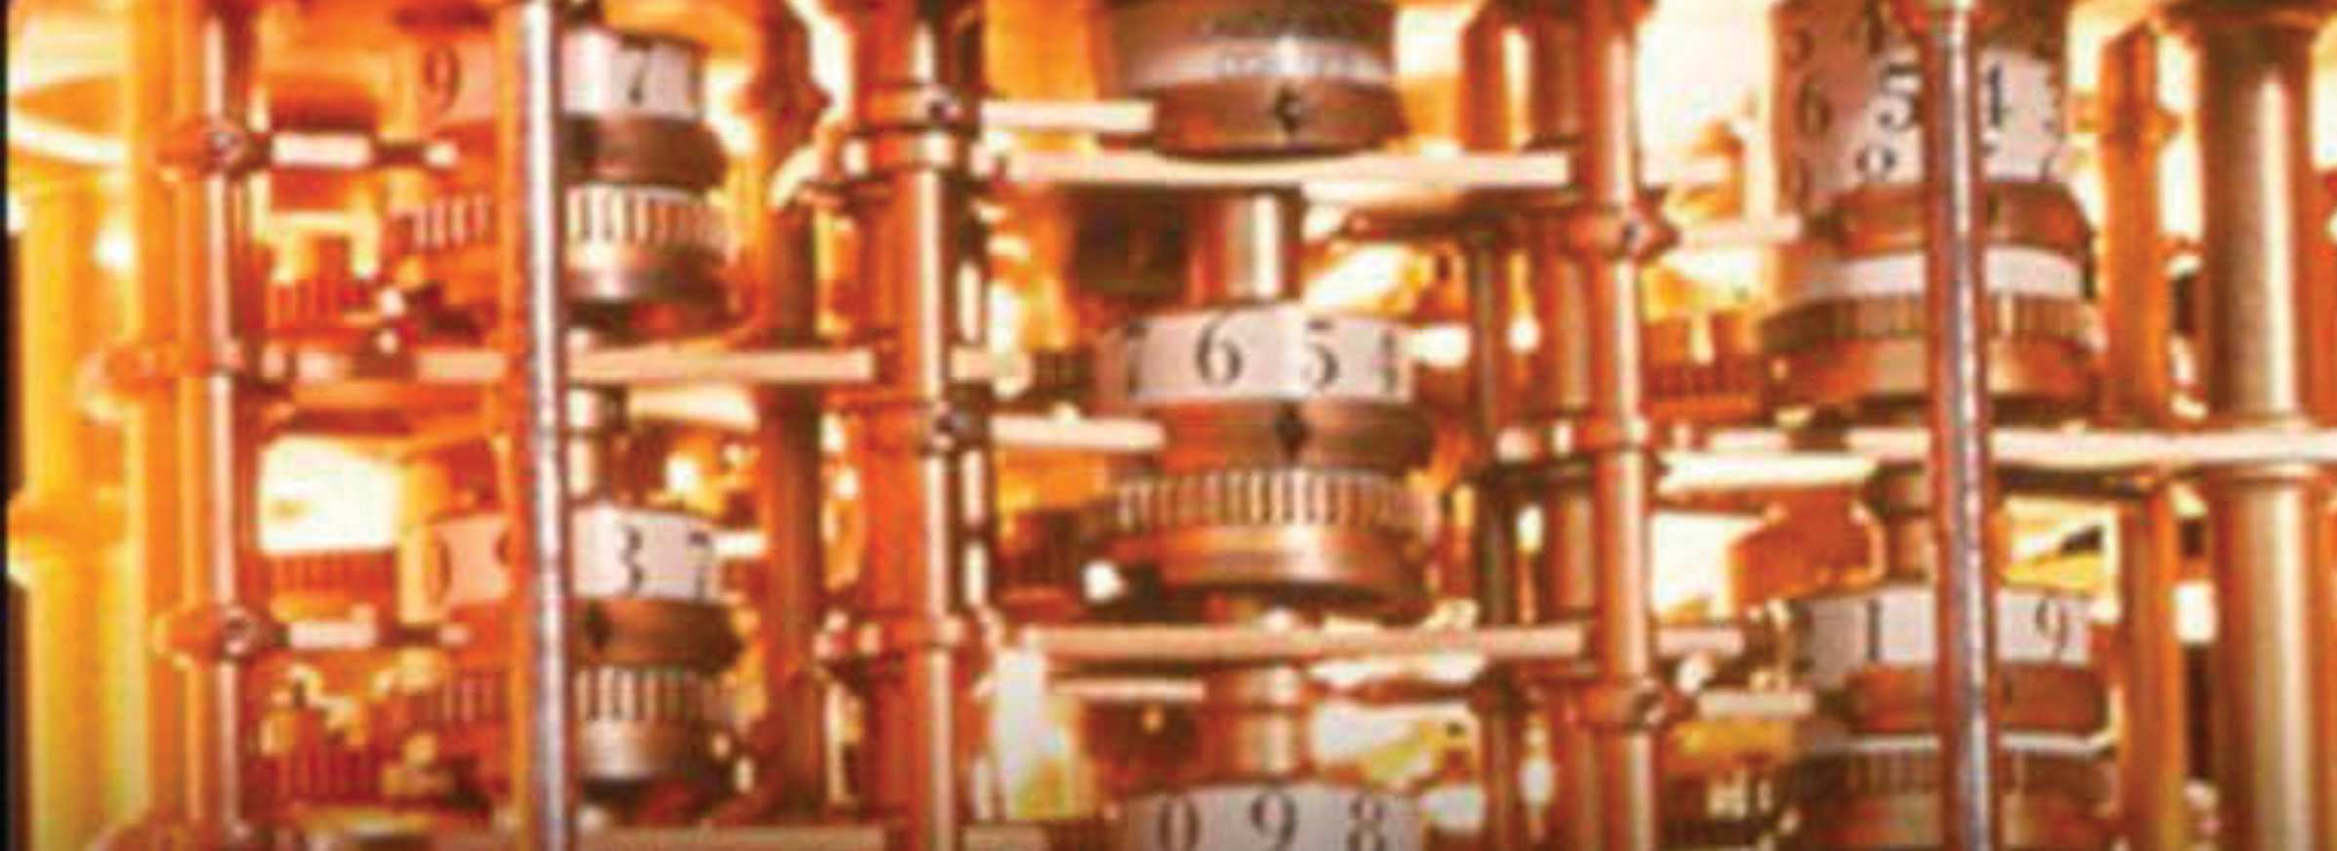





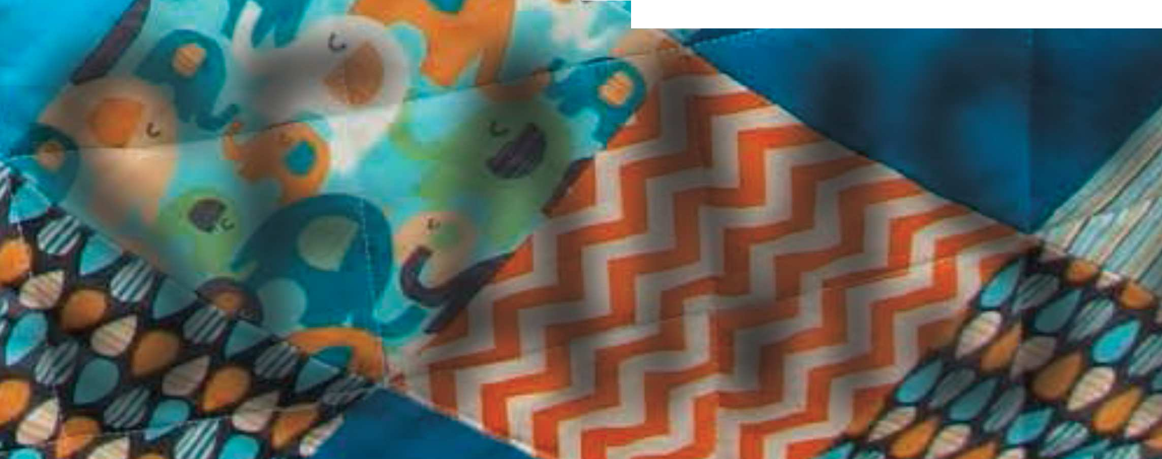
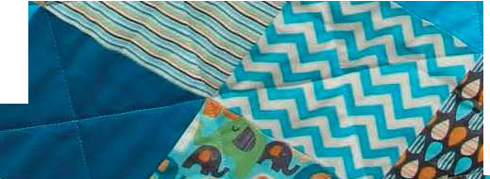


WHERE ARE THE
SEAMS?

Slide 22
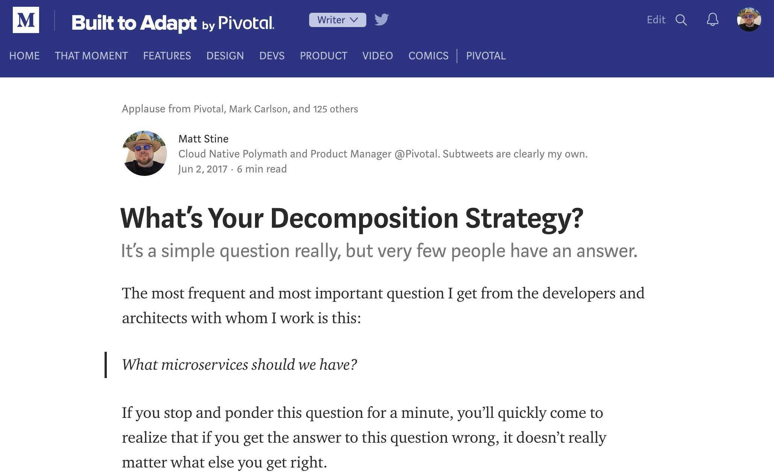
https://builttoadapt.io/whats-your-decomposition-strategy-e19b8e72ac8f

Slide 23
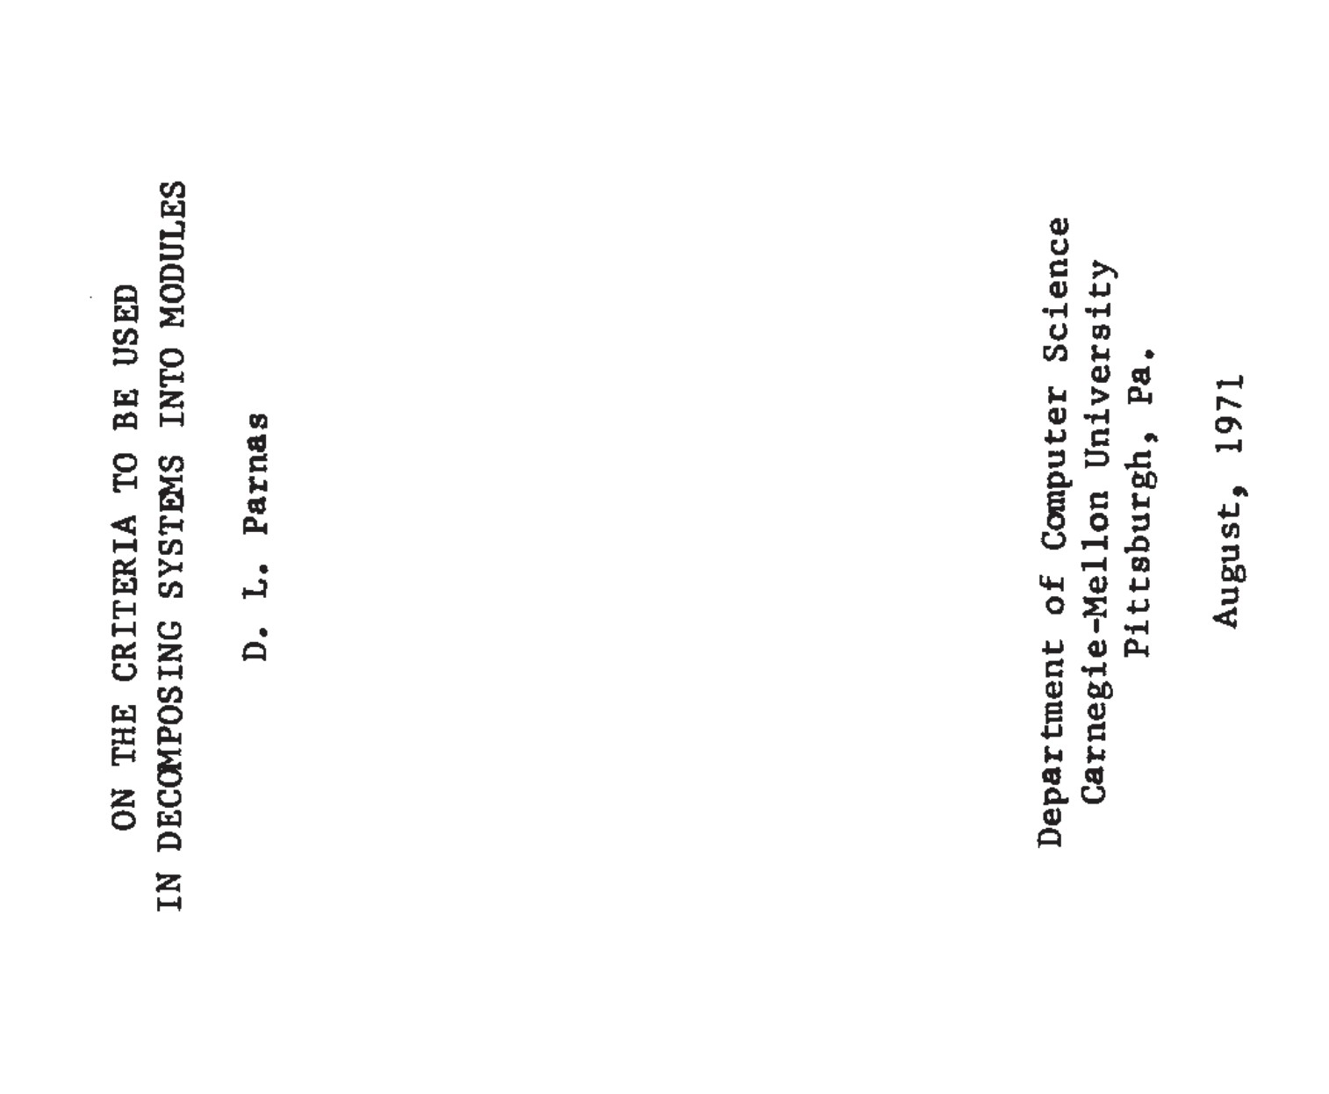

Slide 24
This paper discusses modularization as a mechanism for improving the flexibility and comprehensibility of a system while allowing the shortening of its development time. The effectiveness of a "modularization” is dependent upon the criteria used in dividing the system into modules.

Slide 25
The major progress in the area of modular programming has been the development of coding techniques and assemblers which (1) allow one module to be written with little knowledge of the code used in another module and, (2) allow modules to be reassembled and replaced without reassembly of the whole system.

Slide 26
Let’s build an online store!
Decomposition Techniques

Slide 27
Product Catalog
Orders
Inventory
Payment
Notifications
Fulfillment
Shipping

Slide 28
UI
Services
Data

Slide 29
UI
Services
Domain Model
Data

Slide 30
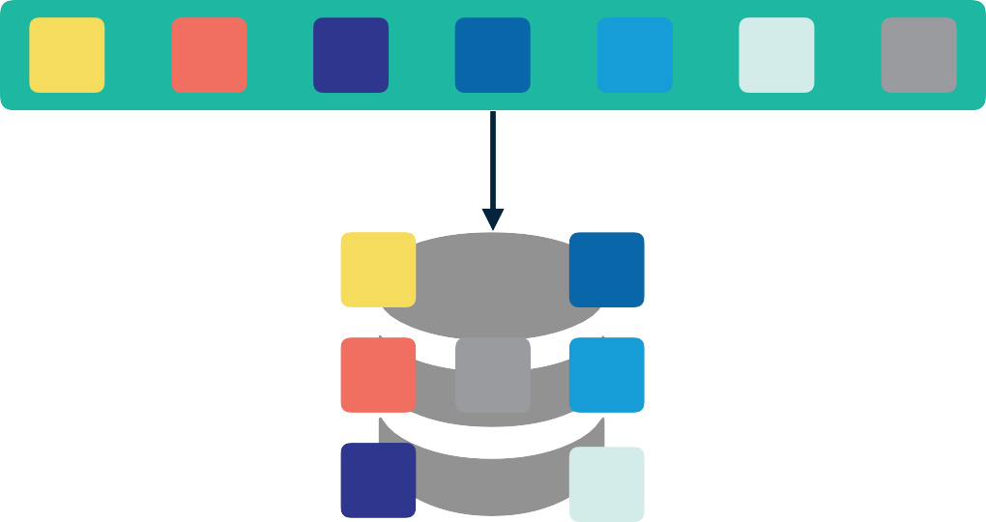
UI
Services
Domain Model
Data

Slide 31
UI
Services
Services
Domain Model
Data

Slide 32
UI
Services
Services
Domain Model
Data

Slide 33
UI
MVC Controllers / Views
Services
Services
Domain Model
Data

Slide 34
UI
MVC Controllers / Views
Services
Services
Domain Model
Data

Slide 35
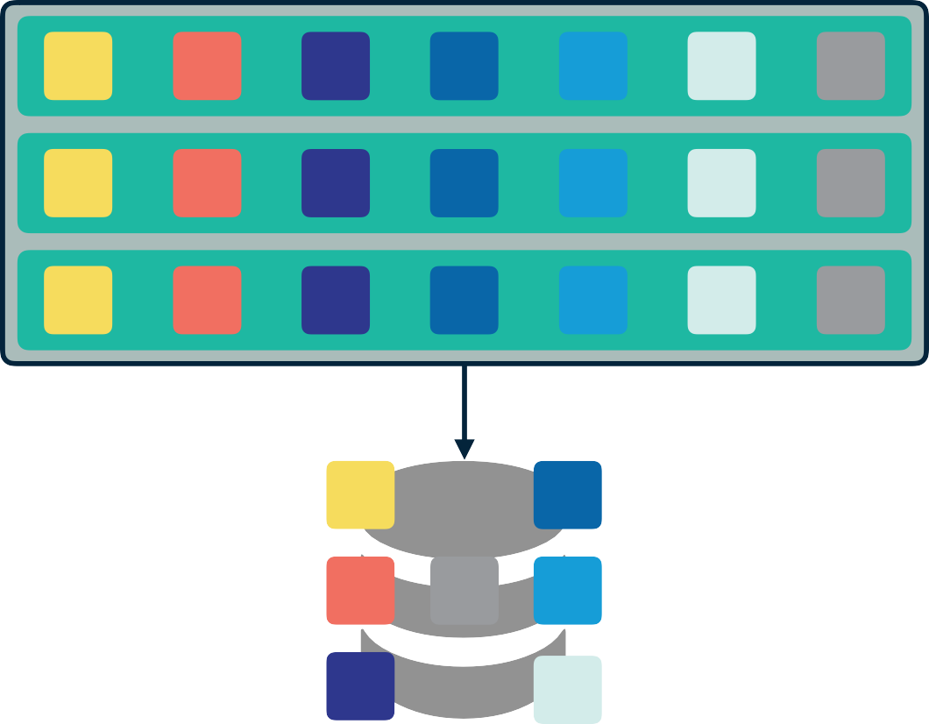
UI
MVC Controllers / Views
Services
Services
Domain Model
Data

Slide 36
UI
MVC Controllers / Views
Services
Services
Domain Model
Data

Slide 37
Functional Decomposition
Changes
Independent Development
Dependent on shared data formats and schema. Must be jointly defined and agreed upon across multiple groups.
Comprehensibility
Struggles with knowledge spread across all modules, so often each module has to change in response to a desired functional change.
You need to know something about how all of the modules work to understand the whole system.

Slide 38
Let’s Refactor to a Capability Decomposition
Decomposition Techniques

Slide 39
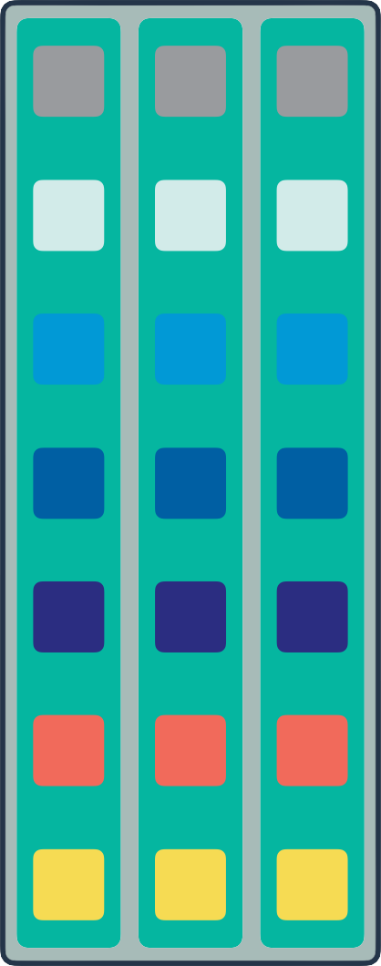

Slide 40
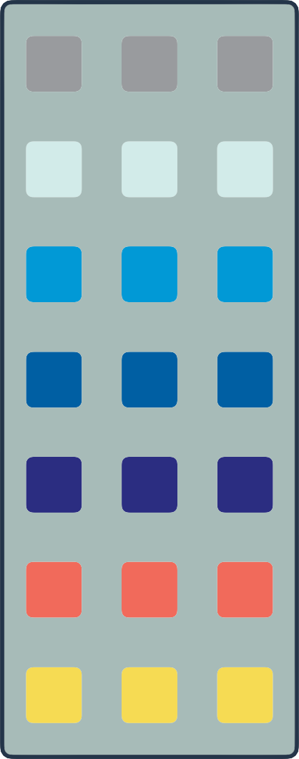

Slide 41
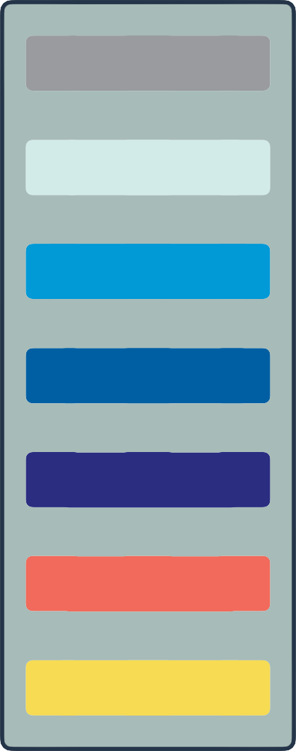

Slide 46
Capability Decomposition
Changes
Independent Development
Has abstract interfaces that encapsulate the work to be done..
Comprehensibility
Usually isolates a change to a single module.
You can understand modules independently.

Slide 47
We have tried to demonstrate…it is almost always incorrect to begin the decomposition of a system into modules on the basis of a flowchart…instead that one begins with a list of difficult design decisions or design decisions which are likely to change.
Each module is then designed to hide such a decision from the others. Since, in most cases, design decisions transcend time of execution, modules will not correspond to steps in the processing…we must abandon the assumption that a module is one or more subroutines, and instead allow subroutines and programs to be assembled collections of code from various modules.

Slide 48
The fundamental ways in which we design modules effectively has not changed in the last 50 years.
Decomposition Techniques

Slide 49

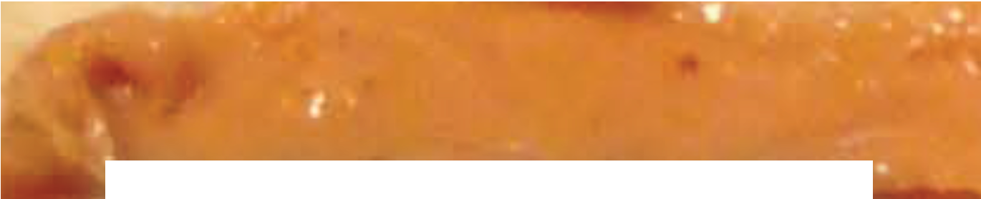
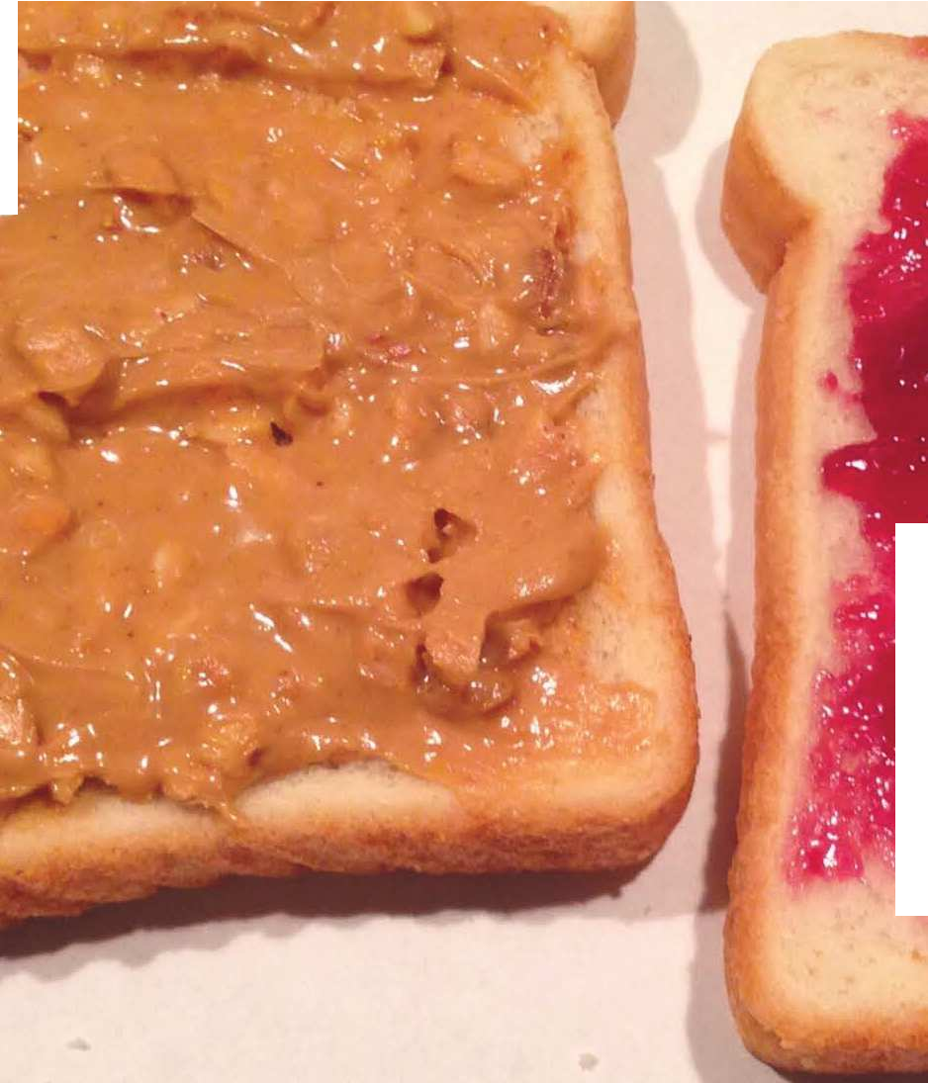
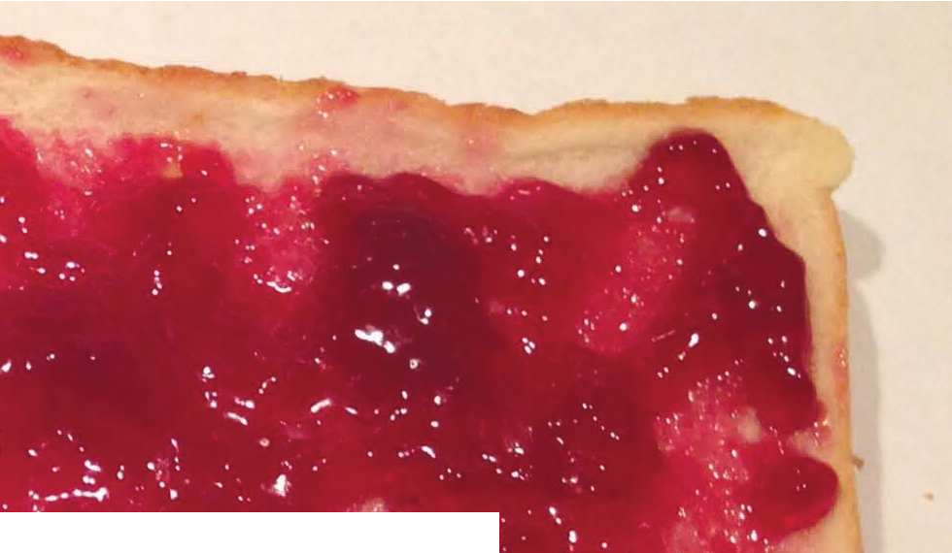



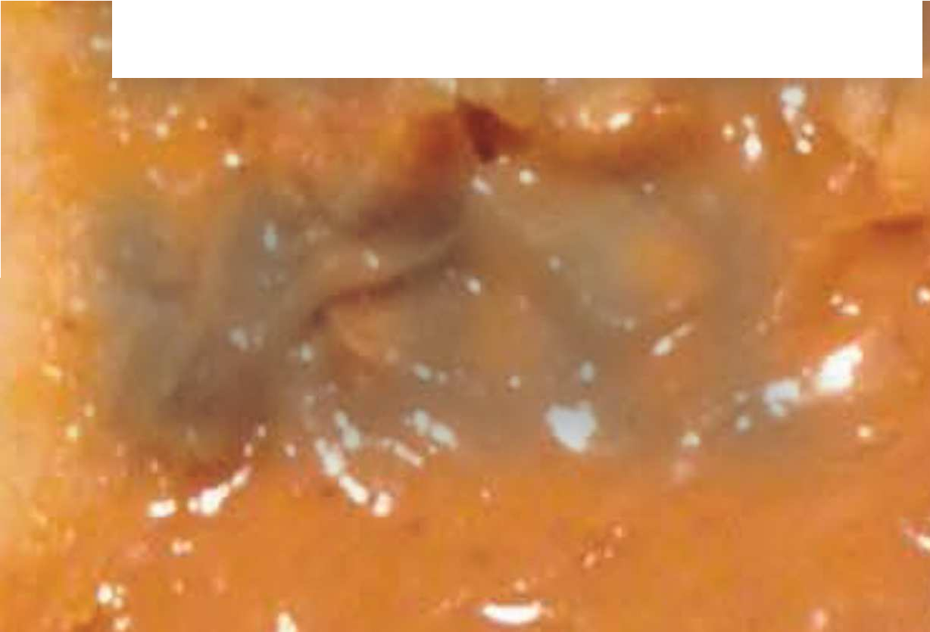









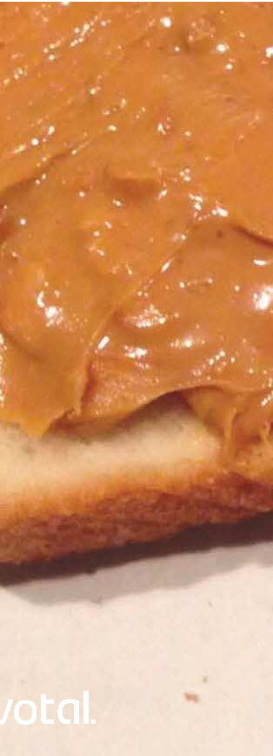
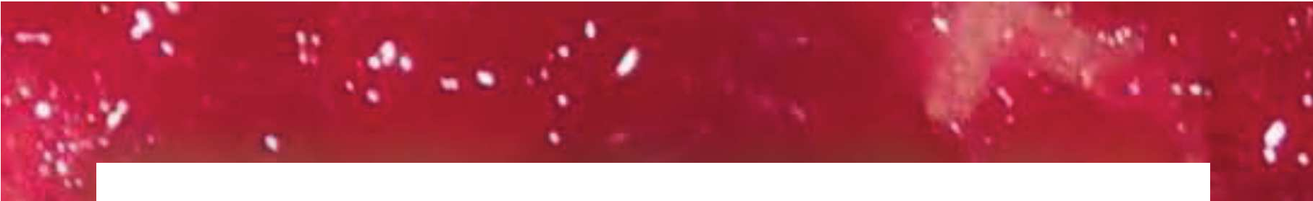
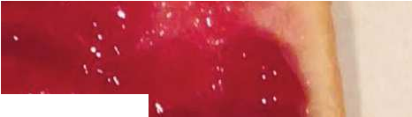



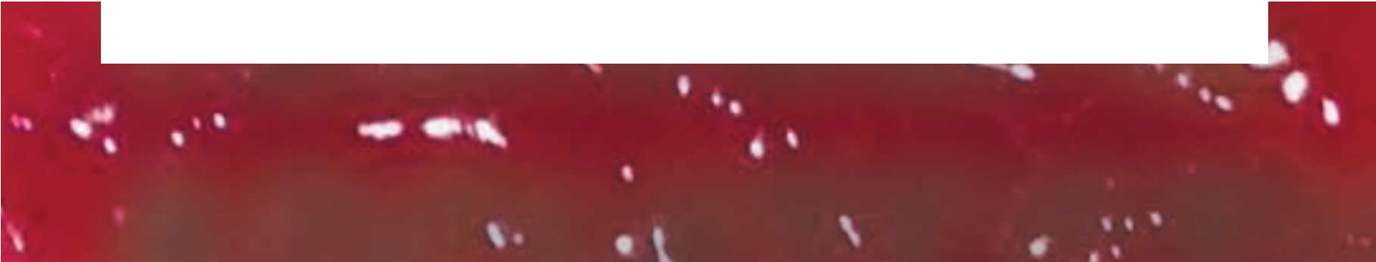









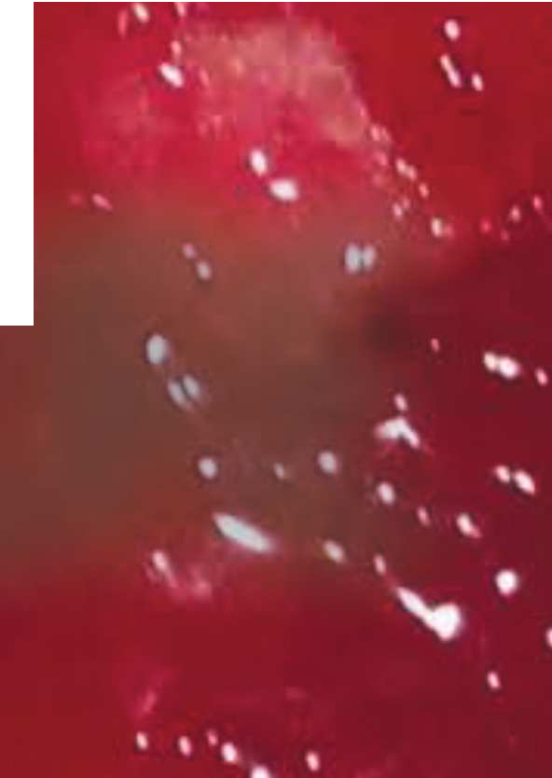


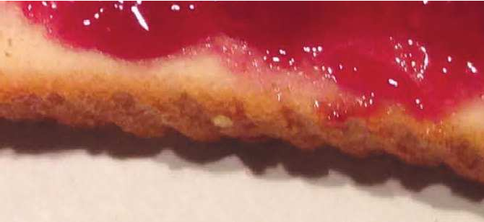



DOMAIN MODEL
TECHNICAL ARCHITECTURE

Slide 50

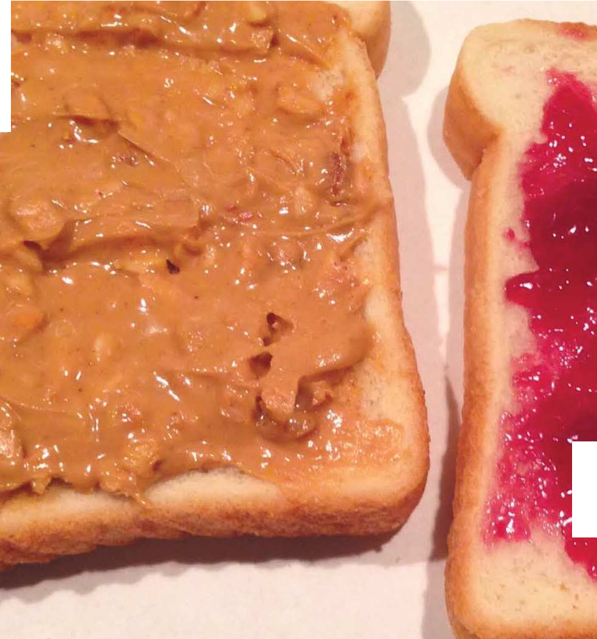
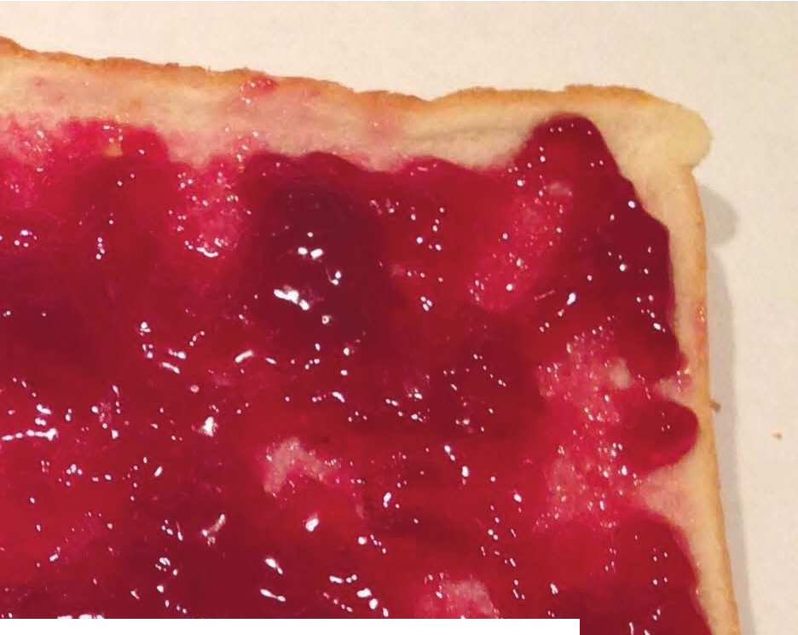






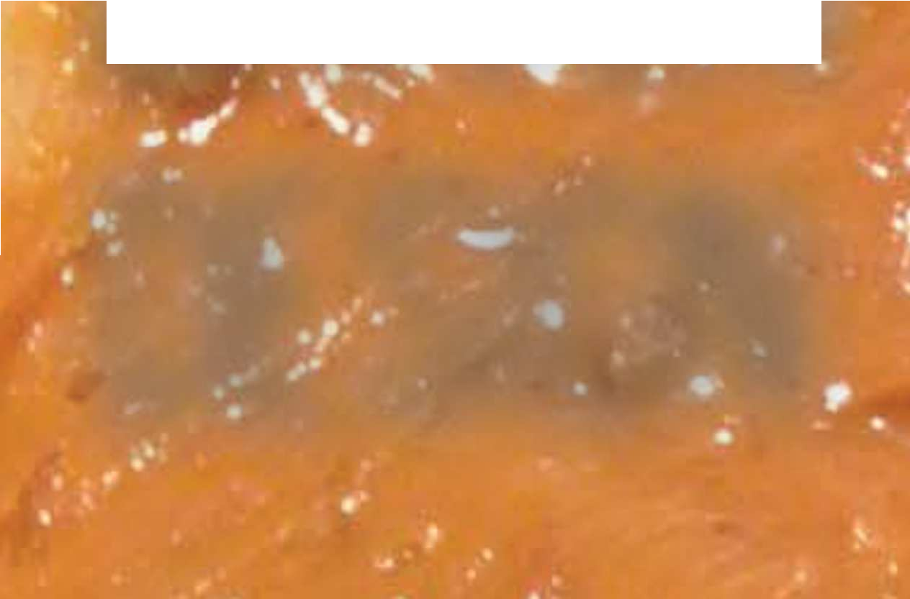







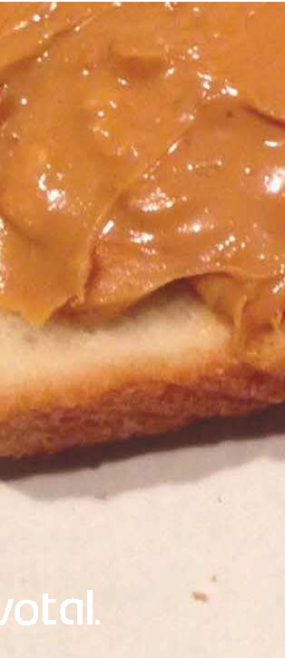

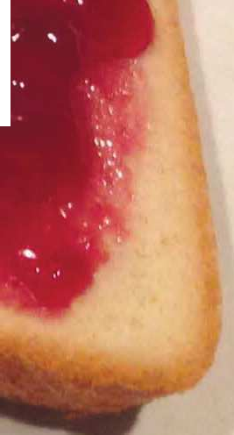
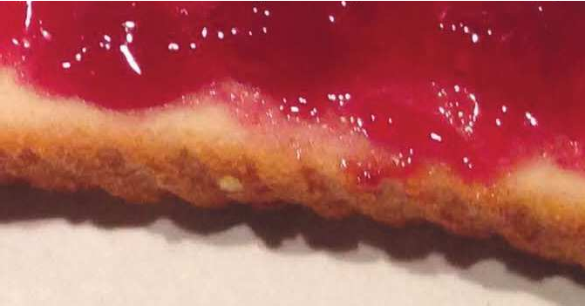

DOMAIN DRIVEN DESIGN
MICROSERVICES

